Slide 1
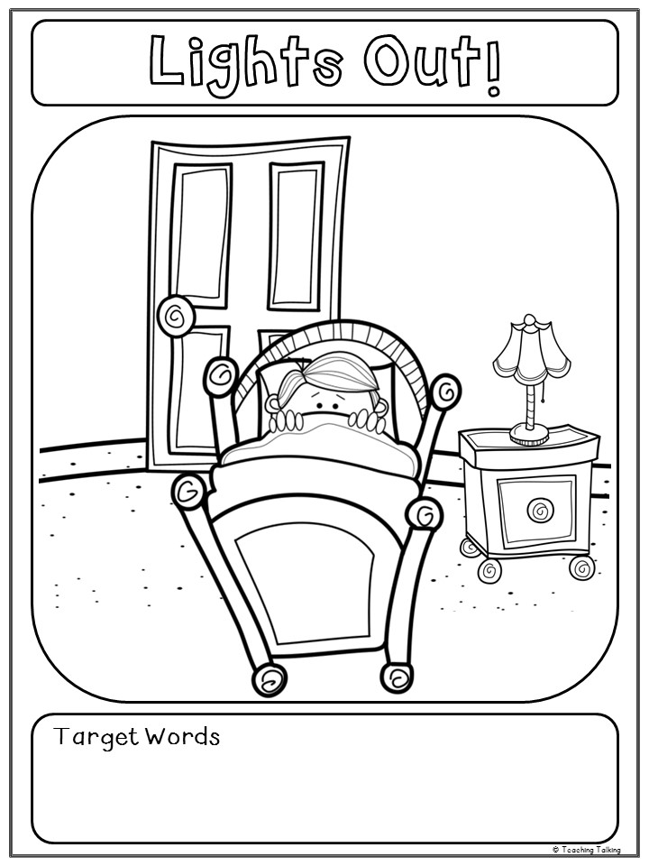
Word 1 | Word 2 | Word 3 | Word 4 | Word 5

