Slide 1
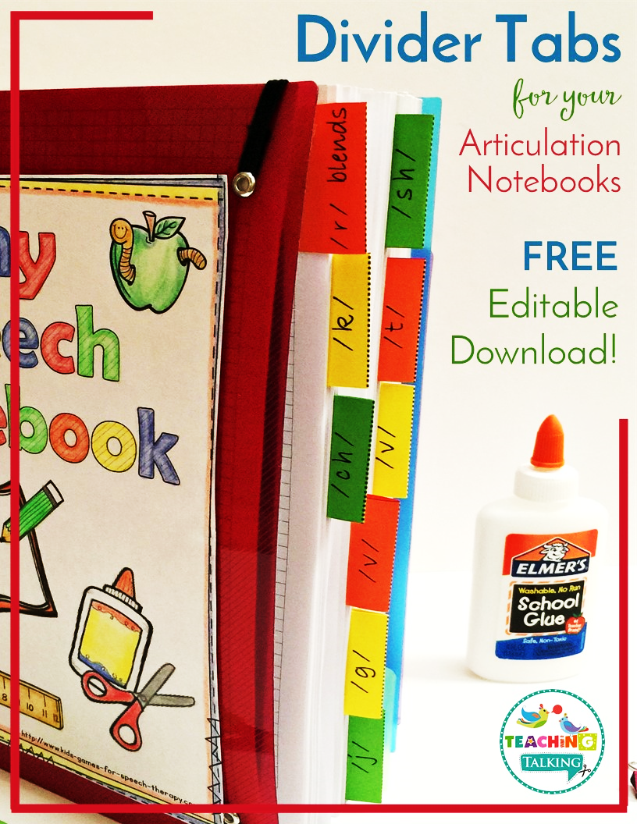

Slide 2
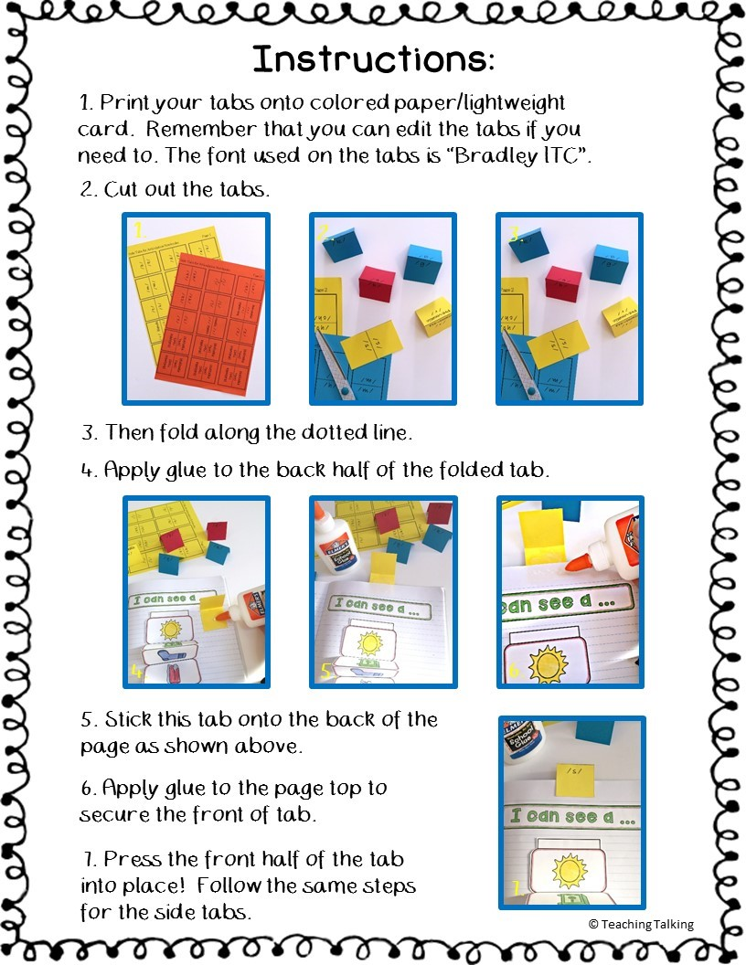

Slide 3
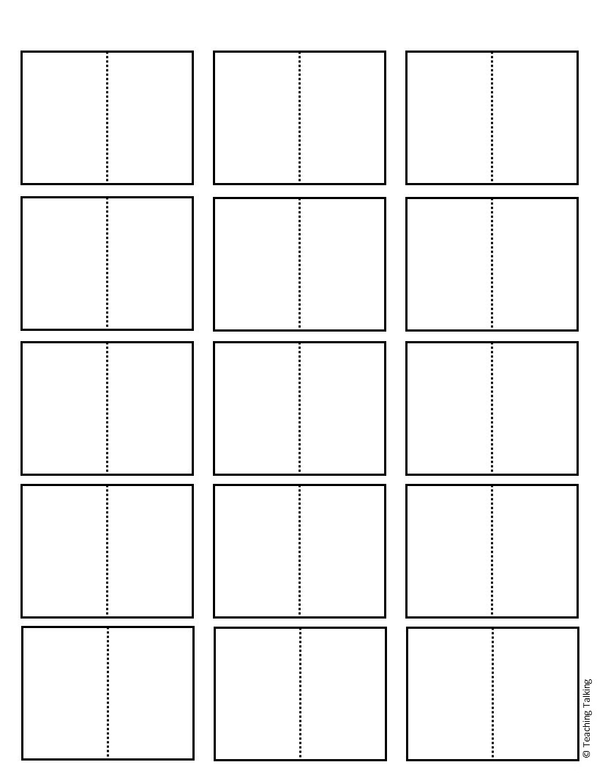
Side Tabs for Articulation Notebooks: Page 1
/d/
/h/
/b/
/d/
/h/
/b/
/m/
/n/
/p/
/m/
/n/
/p/
/t/
/t/
/w/
/w/
/l/ blends
/l/ blends
/f/
/s/ blends
/f/
/r/ blends
/s/ blends
/r/ blends
/g/
/k/
/v/
/g/
/k/
/v/

Slide 4
Side Tabs for Articulation Notebooks: Page 2
/j/
/sh/
/ch/
/j/
/sh/
/ch/
Pre-vocalic /r/
/th/
/l/
Pre-vocalic /r/
/th/
/l/
/s/
/s/
/z/
Vocalic /r/
/z/
Vocalic /r/
(Editable Text)
(Editable Text)
(Editable Text)
(Editable Text)
(Editable Text)
(Editable Text)
(Editable Text)
(Editable Text)
(Editable Text)
(Editable Text)
(Editable Text)
(Editable Text)

Slide 5
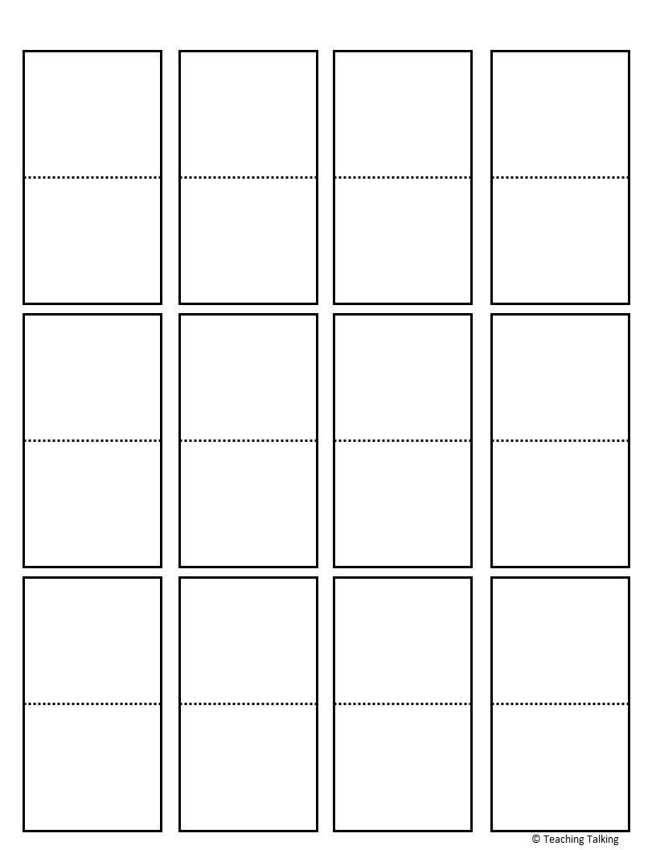
Top Tabs for Articulation Notebooks: Page 1
/b/
/d/
/h/
/m/
/b/
/d/
/h/
/m/
/n/
/p/
/t/
/w/
/n/
/p/
/t/
/w/
/l/ blends
/r/ blends
/s/ blends
/f/
/l/ blends
/r/ blends
/s/ blends
/f/

Slide 6
Top Tabs for Articulation Notebooks: Page 2
/g/
/k/
/v/
/ch/
/g/
/k/
/v/
/ch/
/j/
/sh/
/th/
/l/
/j/
/sh/
/th/
/l/
Pre-vocalic /r/
Vocalic
/r/
/s/
/z/
Pre-vocalic /r/
/s/
Vocalic /r/
/z/

