Slide 2
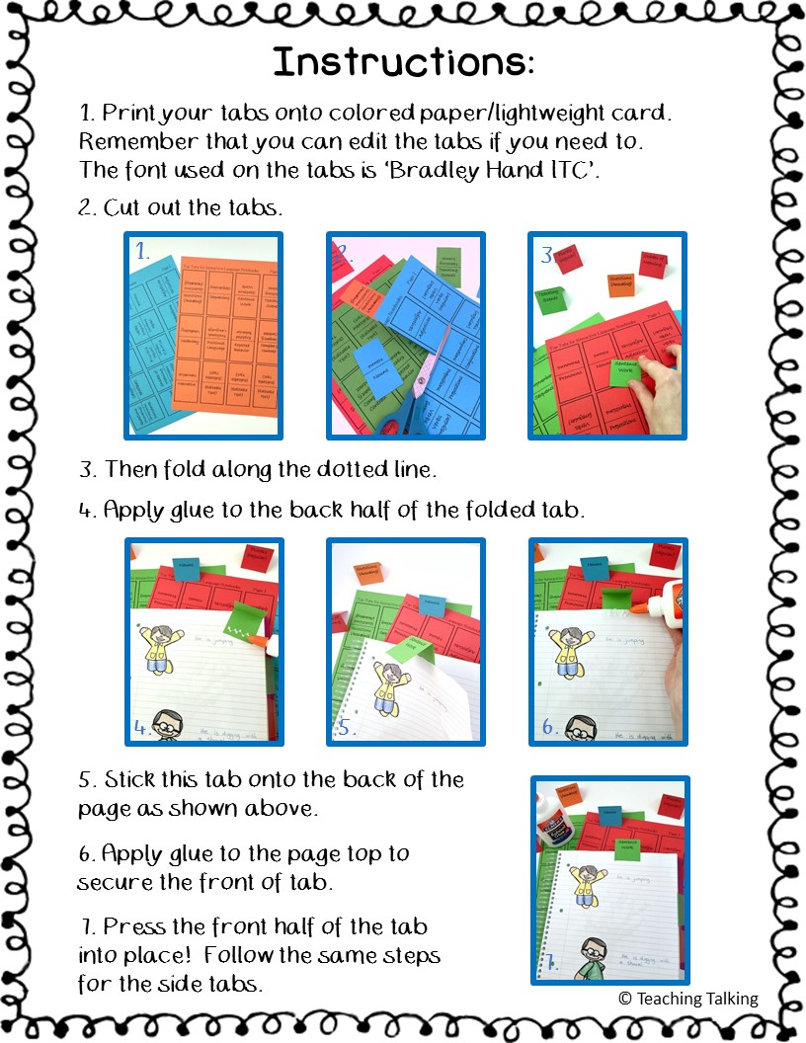

Slide 3
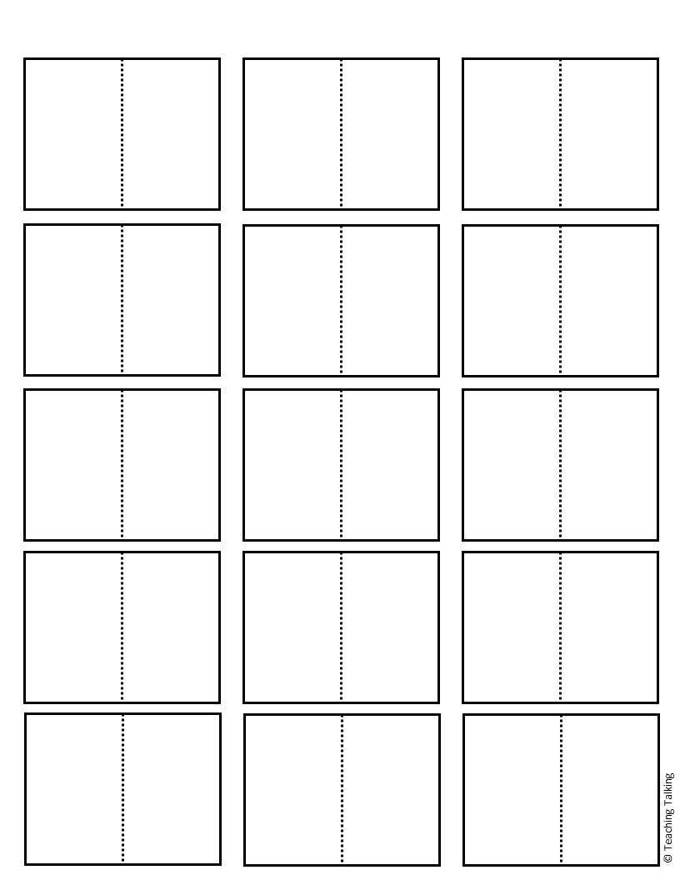
Side Tabs for Interactive Language Notebooks: Page 1
Nouns
Adjectives
Pronouns
Nouns
Adjectives
Pronouns
Verbs
(regular)
Verbs
(regular)
Verbs
(irregular)
Verbs
(irregular)
Prepositions
Prepositions
Conjunctions
Plurals
(regular)
Plurals
(regular)
Plurals
(irregular)
Plurals
(irregular)
Conjunctions
Questions (Asking)
Shades of Meaning
Questions (Asking)
Categories
Shades of Meaning
Categories
Sentence
Work
Questions
(Answering)
Sentence Work
Questions
(Answering)
Sequencing
Sequencing

Slide 4
Side Tabs for Interactive Language Notebooks: Page 2
Teaching Scenes
Positional Language
Teaching Scenes
Vocabulary
Positional Language
Vocabulary
Expected Behavior
Expected Behavior
Compare & Contrast
Compare & Contrast
Narrative
Narrative
(Editable Text)
(Editable Text)
(Editable Text)
(Editable Text)
(Editable Text)
(Editable Text)
(Editable Text)
(Editable Text)
(Editable Text)
(Editable Text)
(Editable Text)
(Editable Text)
(Editable Text)
(Editable Text)
(Editable Text)
(Editable Text)
(Editable Text)
(Editable Text)

Slide 5
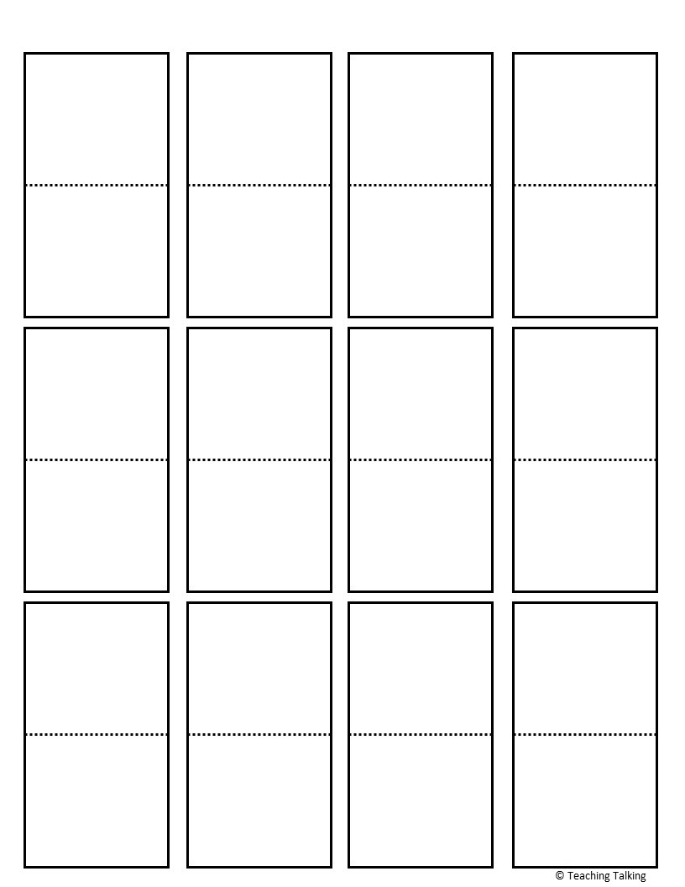
Top Tabs for Interactive Language Notebooks: Page 1
Verbs (regular)
Pronouns
Nouns
Adjectives
Pronouns
Nouns
Adjectives
Verbs (regular)
Verbs (irregular)
Plurals (regular)
Prepositions
Conjunctions
Verbs (irregular)
Prepositions
Conjunctions
Plurals (regular)
Plurals (irregular)
Shades of Meaning
Questions (Asking)
Categories
Plurals (irregular)
Categories
Shades of Meaning
Questions (Asking)

Slide 6
Top Tabs for Interactive Language Notebooks: Page 2
Questions (Answering)
Sentence Work
Teaching Scenes
Sequencing
Questions (Answering)
Sequencing
Sentence Work
Teaching Scenes
Positional Language
Expected Behavior
Compare & Contrast
Vocabulary
Vocabulary
Positional Language
Expected Behavior
Compare & Contrast
(Editable Text)
(Editable Text)
(Editable Text)
Narrative
Narrative
(Editable Text)
(Editable Text)
(Editable Text)

